Slide 1
One model to learn them all
Lukasz Kaiser et al.,2017

Slide 2
Outline
Background
2 Keys of MultiModel architecture
MulitModel architecture
Experiments

Slide 3
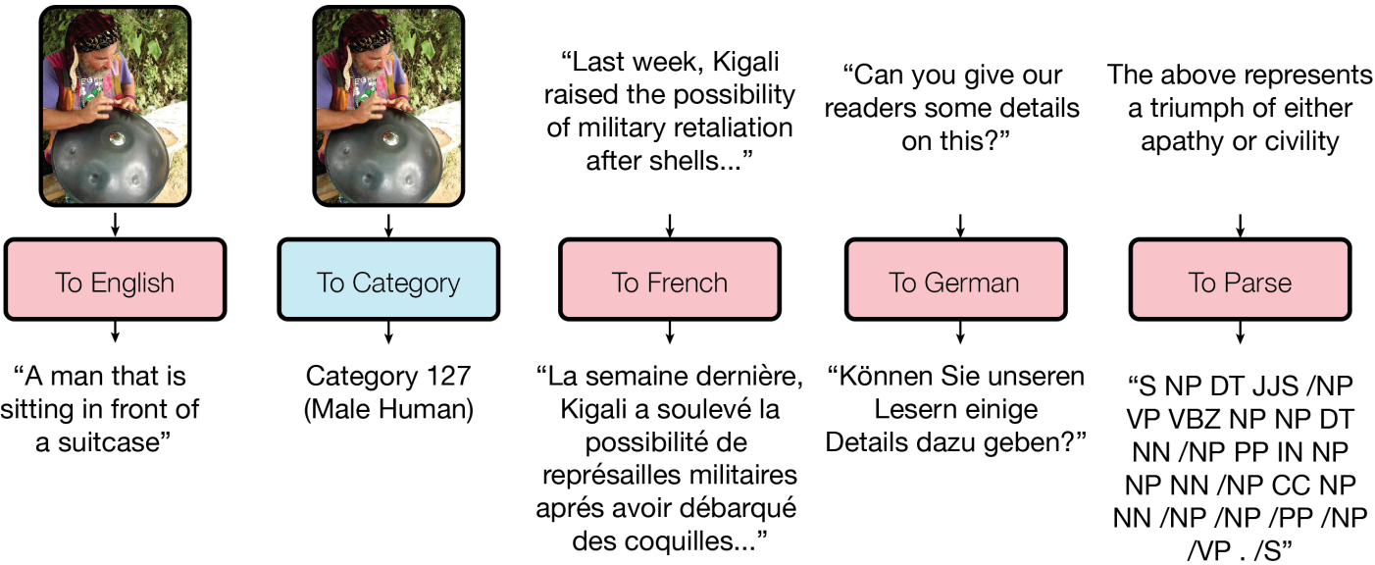
Background
CNN excels at tasks related to vision, rnn have proven successful at nlp.They were all designed for the problem at hand
Can we create a unified deep learning model to solve tasks across multiple domains?

Slide 4
Small modality-specific sub-networks
To allow training on input data of widely different sizes and dimensions(images, text, sound waves), we need subnetworks to convert inputs into a joint representation space.
The unified representation is variable-size
Different tasks from the same domain share modality nets

Slide 5
Computational blocks of different kind are crucial
Depthwise-separable convolutions
Attentation mechanism
Sparsely-gated mixture-of-experts layers

Slide 6
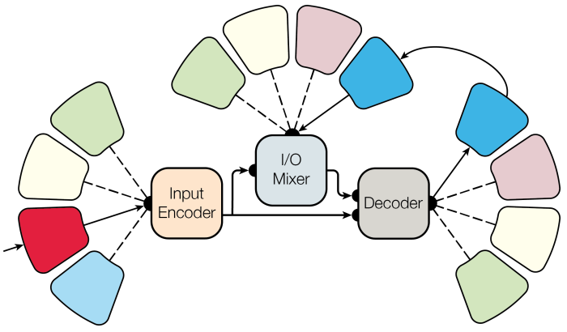
MultiModel Architecture
Notes:
复合模型由几个modality-nets 一个编码器，一个解码器，以及一个输入输出mixer组成
其中encoder以及decoder因为有以下模块的存在使得表现效果很好
1 convolutions
2 attentation layers
3稀疏门控专家混合层

Slide 7
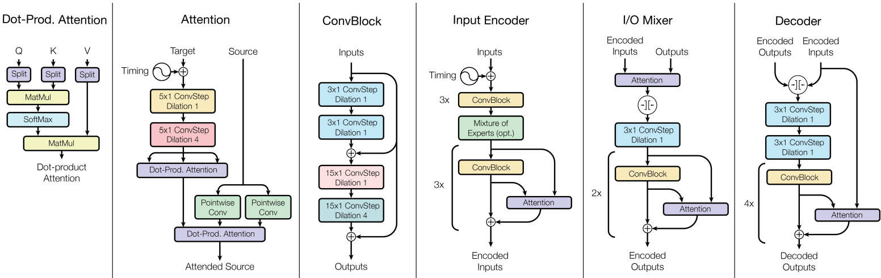
MultiModel Architecture

Slide 8
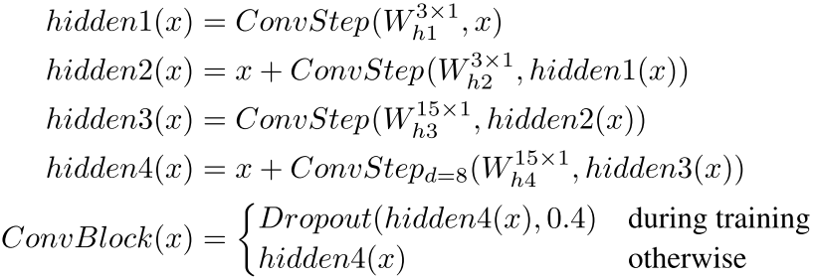
Convolutional Block
We use deapthwise separable convolutions
Thry are defined by a convolution on each feature channel separately, followed by a pointwise convolution to project to the desired feature depth

Slide 9
Attentation Blocks
We use multi-head dot-product attention mechanism
The inputs to the attention layer are 2 tensors: a source tensor and target tensor both with the shape [batch size, sequence length, feature channels]

Slide 10
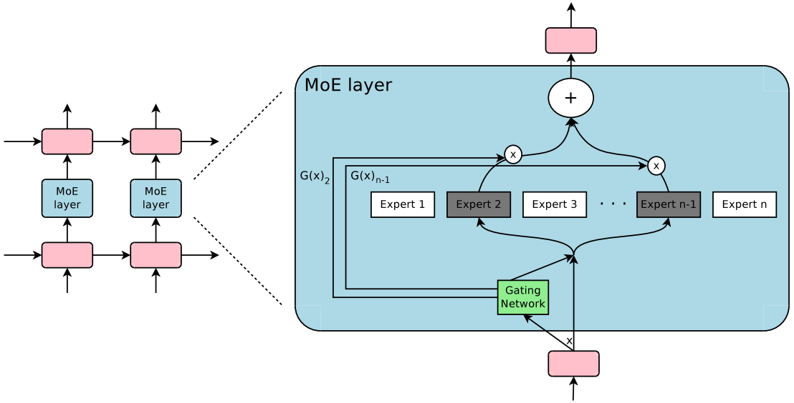
Mixture-of-Experts Blocks
Notes:
很多网络不用，所以稀疏，大规模训练的时候，在模型容量上有超过1000倍的提升，在计算效率上只有微小的损失

Slide 11
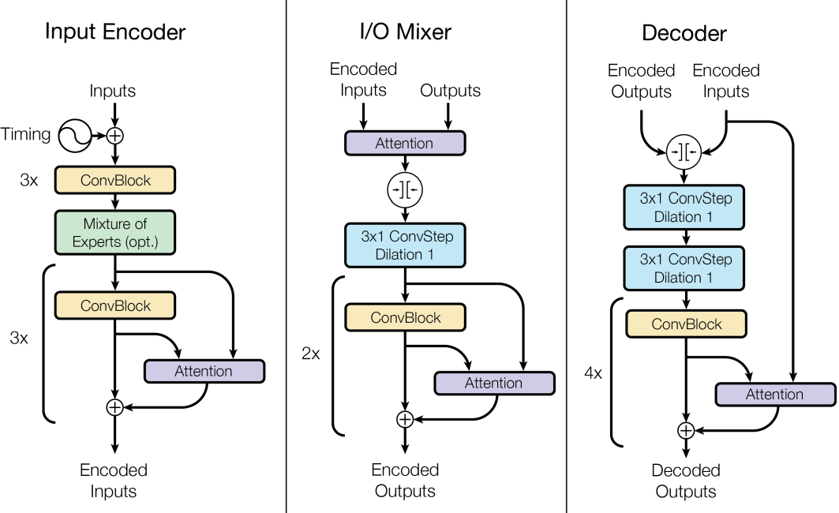
Encoder and Mixer and Decoder
Notes:
简述网络层的组成

Slide 12
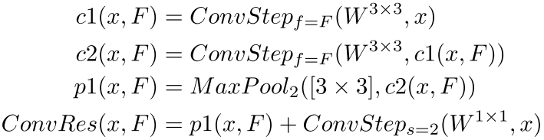
Modality Nets-image modality net
The input image’s feature depth is gradually deepened using residual convolution blocks which we call ConvRes and define as follows

Slide 13
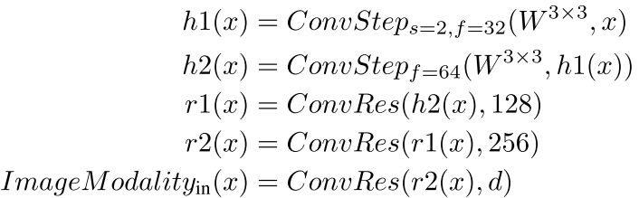
Modality Nets-image modality net
The imageModality input flow with network depth d(we use d=1024) is defined as:

Slide 14
Experiments
Implemented the multimode architecture using tensorflow
In all training runs reported below we used the same set of hyper-parameters and the Adam optimizer with gradient clipping

Slide 15
Experiments
1. How far is the multimodel trained on 8 tasks simultaneously from state-of-the-art results?
2. How does training on 8 tasks simultaneously compare to training on each task separately?
3. How do the different computational blocks discussed above influence different tasks?

Slide 16
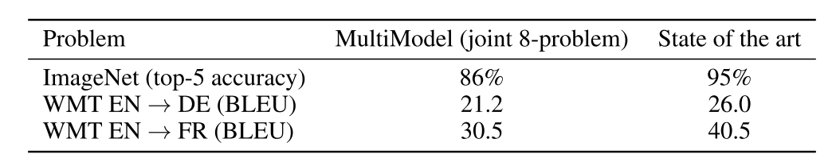
Experiments
1. How far is the multimodel trained on 8 tasks simultaneously from state-of-the-art results?

Slide 17
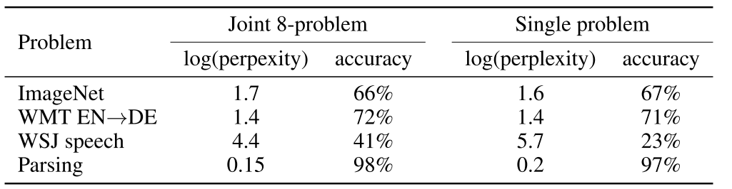
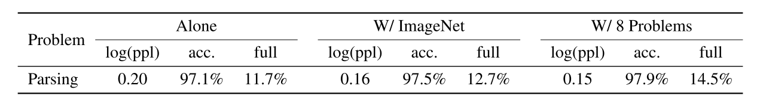
Experiments
2. How does training on 8 tasks simultaneously compare to training on each task separately?

Slide 18
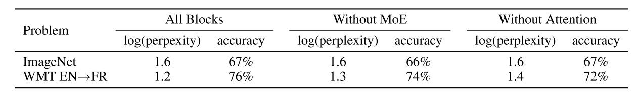
Experiments
3. How do the different computational blocks discussed above influence different tasks?

